Slide 1

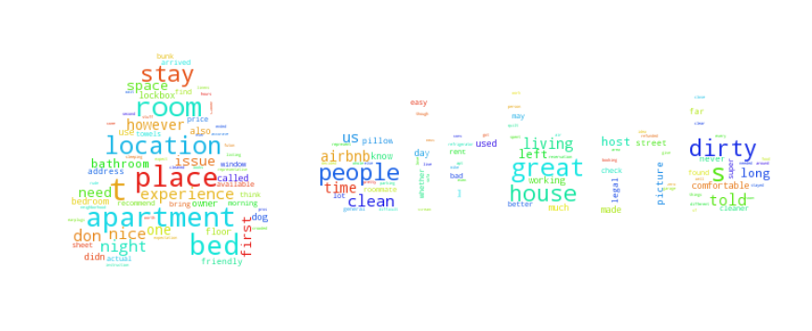
Mad Sentiment Analysis on Airbnb Data

Slide 2
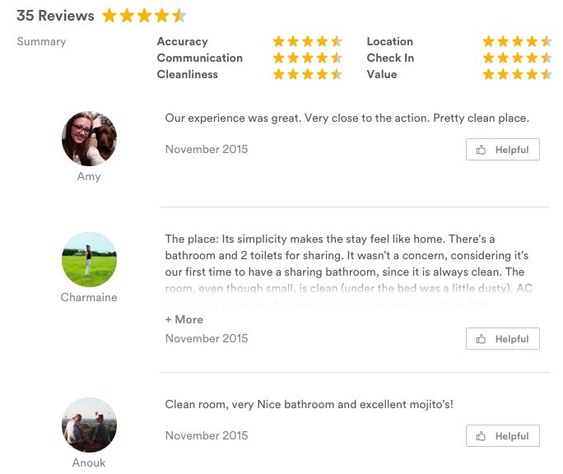
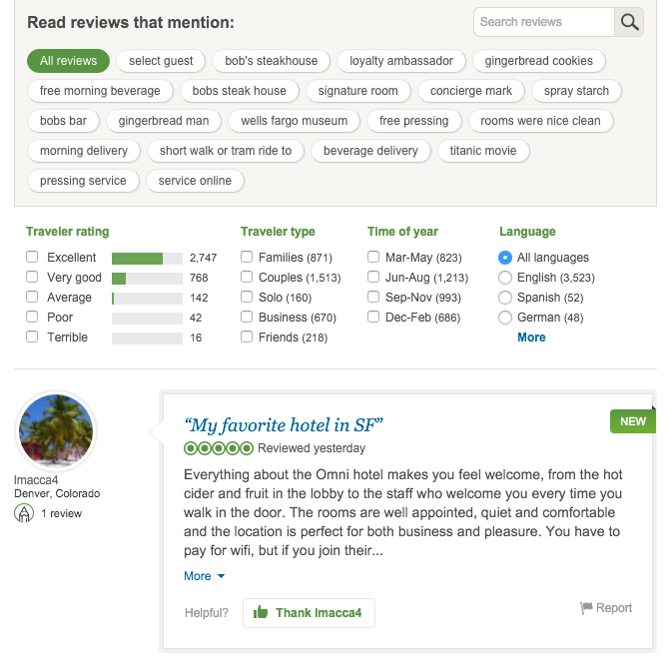
Motivation/Issue
On Airbnb, individual review ratings are hidden unlike other services.
Airbnb
Trip Advisor
Source：Airbnb, Trip Advisor

Slide 3

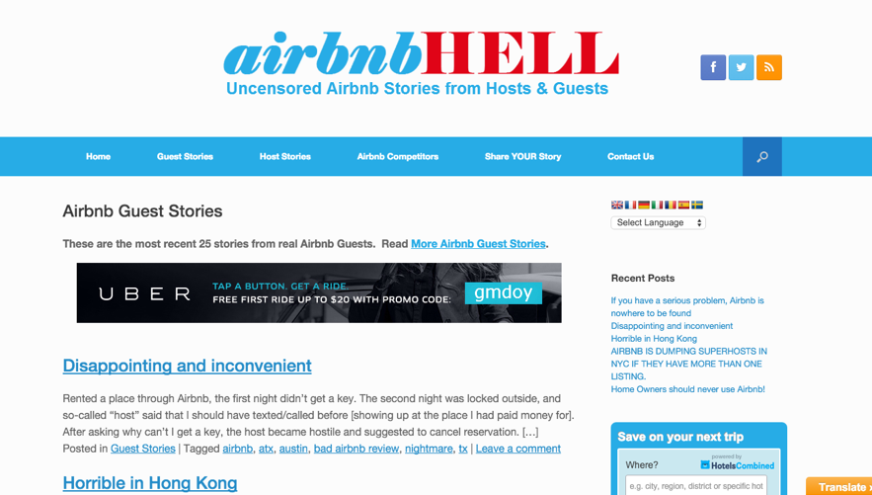
Motivation/Issue
Easy to miss potential risks that may have been experienced by Airbnb users and mentioned somewhere in reviews
For me…
For others…
Give sentiment label for each review and focus on extracting negative reviews
Source：airbnbhell.com

Slide 4
Project Overview
(^O^) : Happy with output
(・_・) : Okay with output
(´・ω・`) : Disappointed with output
Data Clearning
Label Review Data
Modeling
Further Research
Topic modeling/label via keyword
Alchemy Sentiment Analysis API
Bag of words
Random Forest
SVM
Word2Vec
Random Forest
SVM
Word2Vec/K-means
Various models
Bagging SGD
Data Product
Label review data with model trained with competitor sites
Dataset merging
Review language detection
(・_・)
(^O^)
(・_・)
(・_・)
(^O^)
(^O^)
(^O^)
EDA
Further Research
Who are the host?
Reservation seasonality with location (zipcode)
Reservation seasonality in general
Reservation seasonality with pricing
Top undervalued places?
Word cloud based on sentiment
Visualize on map
Feature selection and interaction with regression problems
(´・ω・`)
(´・ω・`)
(^O^)
(・_・)
(^O^)
(^O^)

Slide 5


Further Research: Data Product
A simple site that tells if the Airbnb room has potential risks
Input page
Output page
No risk
Risk
How I do it:
Use Flask to make a minimum viable site
Use Kimono lab to scrape reviews from a given url
Use my trained model to predict sentiment of the reviews
If len(negative reviews) is 0: direct to “Good to go” page
Otherwise, output negative reviews on “Oh no” page

Slide 6
Further Research: Other todo
Label review data with model trained with competitor sites
Use Trip Advisor review data
Label 4 and 5 as positive, 3 as neutral, 1 and 2 as negative
Train the model and apply it to Airbnb review data
Visualize on map
Learn Vincent library
Visualize price range/sentiment/number of reviews based on zipcode or address
Feature selection and engineering with regression problems
Run regression analysis making price/number of reviews as y and other attributes (# rooms, location, sentiment etc) as predictors
Try feature engineering and selection with Statsmodel and Sklearn

